Slide 1
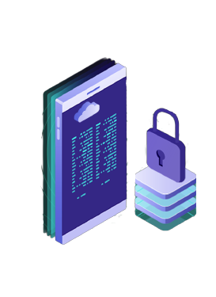

Proteus Prime
ISTE VIT

Slide 2
MICROPROCESSOR VS MICROCONTROLLER
MICROPROCESSOR
MICROCONTROLLER
A component that performs the instruction and task involved in computer processing
Used for applications that require intensive processing
Memory, IO ports, timers, etc. are connected to the CPU externally
Perform multiple tasks and requires more memory and has high clock speed
32bit or 64bit
Uses USB, UART, and high speed Ethernet as the peripheral interfaces
It is larger, cost more and consumes more power
Used by personal computers and laptops.
A compact integrated circuit design for a specific operation in an embedded system
Used for an application that performs a particular task
CPU and all other elements are integrated into a single chip or board
Performs a single task and does not require more memory and IO ports and has lower clock speed
8 bit, 16bit or 32bit
Uses 12C, UART and SPI for the peripheral interfaces
It is smaller, cost less and consumes less power
Used by microwave ovens and washing machines.

Slide 3
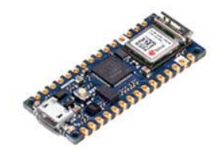
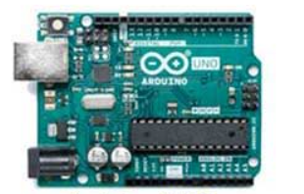
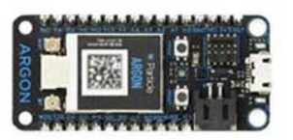
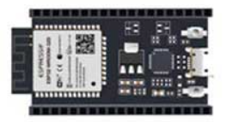
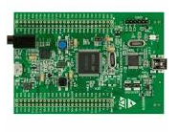
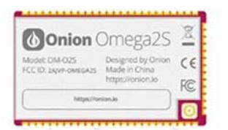
TYPES OF DEVELOPMENT BOARD
Arduino Nano 33 Arduino Uno Particle Argon
ESP32 Raspberry Pi Onion Omega2s+

Slide 4

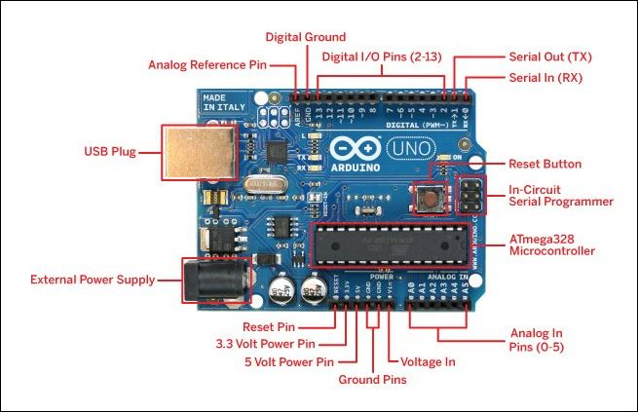
ARDUINO UNO LABELLING

Slide 5

INTRO TO PROTEUS
It is developed by Labcenter Electronics Ltd.
Mainly used to design and Simulate Electrical and Electronic Circuits.
Using the Add Libraries function, one can import various resources like Arduino, Raspberry Pi Design Suites (Includes Sensors and Modules also).
Similar Softwares: NI Multisim, Cadence Orcad.

Slide 6
INTRO TO PROTEUS
Proteus PCB Design : Proteus PCB tools seamlessly combines schematic capture and PCB layout to provide a powerful, integrated and easy to use suite of tools for professional PCB Design.
Proteus Circuit Stimulation : Design, Test and Debug complete embedded systems inside schematic capture before ordering a physical prototype. VSM brings AGILE development to the embedded workflow.
Proteus Visual Designer : A complete workflow for designing an Arduino™ or Raspberry Pi® appliance and then controlling it remotely from a phone or browser. Design, simulate and deploy directly from Proteus.

Slide 7
Thank You
Connect with us :
1)Website : https://istevit.in/
2)Instagram : https://instagram.com/iste_vit_vellore
3)Facebook : https://facebook.com/ISTE.VIT
4)Linkedin:https://www.linkedin.com/company/indian-society-for-technical-education/
5)Github: https://github.com/ISTE-VIT

